Slide 1
“Efficient Generation of Tradespaces for Complexity Allocation in Complex Systems” Presented at the 62nd Annual Meeting of the International Society for the Systems Sciences (ISSS) Corvallis, Oregon, United States July 23, 2018 Farouk Bonilla, Shahram Sarkani, and Thomas Mazzuchi (farouk_bonilla@gwu.edu, sarkani@gwu.edu , mazzu@gwu.edu)

Slide 2
“Better decision support methods to facilitate analysis of multiple alternative designs and optimization of Complex Systems (CS) with multiple variables and uncertainty” has been identified by INCOSE vision 2025 as one of the top needs of the Systems Engineering practice.
MOTIVATION
“As systems increase in scale and complexity, Systems Engineering (SE) is increasingly recognized worldwide for its importance in their development, deployment, operation, and evolution” [SEBoK, 2014]

Slide 3
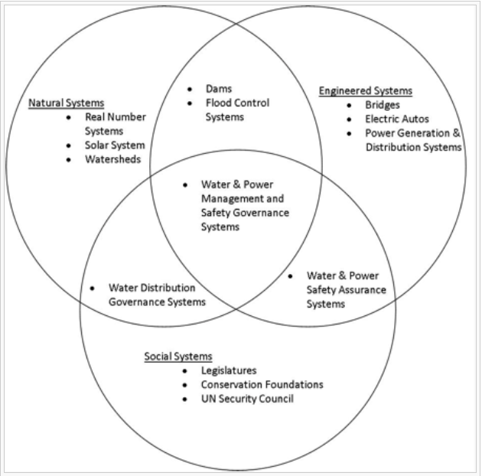
CONTEXT What is a system?
System:
“Set of different elements so connected or related as to perform a unique function not performable by the elements alone”
[E. Rechtin, 1991]
System Boundaries of Engineered Systems, Social Systems, and Natural Systems.
[SEBoK, 2014 Original]

Slide 4
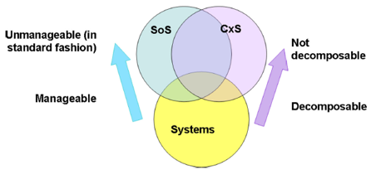
CONTEXT What is complexity and what is a Complex System (CxS)?
Complexity: System property related to the number of interrelated entities, interconnections, and level of abstraction of their relationships [E. Crawley, et al., 2016]
Complex Systems (CxS): Systems that have many autonomous components, tend to evolve and self-organize, and display an emergent behavior as a result of the dependence of the whole on parts, relationships between its constituent elements, and interactions of the whole and elements with the environment. [S. A. Sheard and A. Mostashari, 2008]
[S. A. Sheard and A. Mostashari, 2008 -Original-]

Slide 5
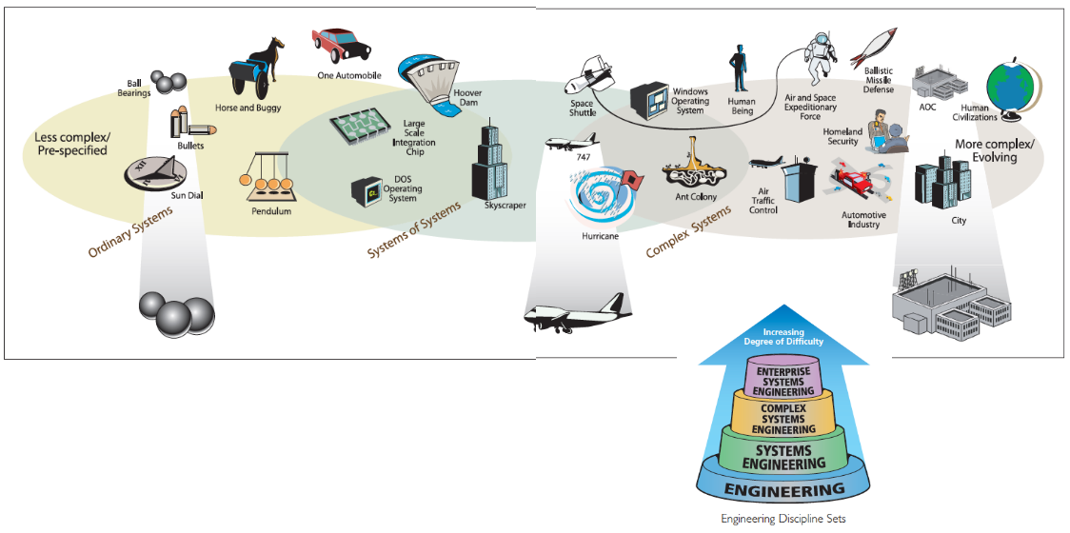
CONTEXT How Complex System (CxS) differs from System of Systems (SoS)?
B. Castellani, online -Original- ]
Examples of ordinary systems, SoS and CxS

Slide 6
Research Question: How the solution space can be generated within reasonable demand of resources and without sacrificing information regarding design parameters interaction to provide decision makers with sufficient architectural structural complexity information about the system of interest? Hypothesis: Trade spaces can be populated efficiently to facilitate the assessment of strategies for allocation and management of complexity within the system. Why is it relevant? Current approaches for generating trade spaces are either time consuming, highly resource demanding, or may left out important factors interaction information. Decision makers would benefit from a more efficient process while getting sufficient information to examine management and allocation of complexity. Complexity is highly correlated to performance, schedule, cost, and risk. Having this information handy and timely would allow them to make informed design decisions, which can be inexpensively introduced at this phase rather than later in the product life cycle, where architectural changes are undesirable.
PROJECT DESCRIPTION

Slide 7
Literature Review
Previous literature has focused on finding metrics to quantify complexity, looking at individual attributes in the tradespace, or jumping directly into optimization based on already assumed generated trade spaces. However, no work has been focused on how to generate trade spaces efficiently accounting for complexity allocation.

Slide 8
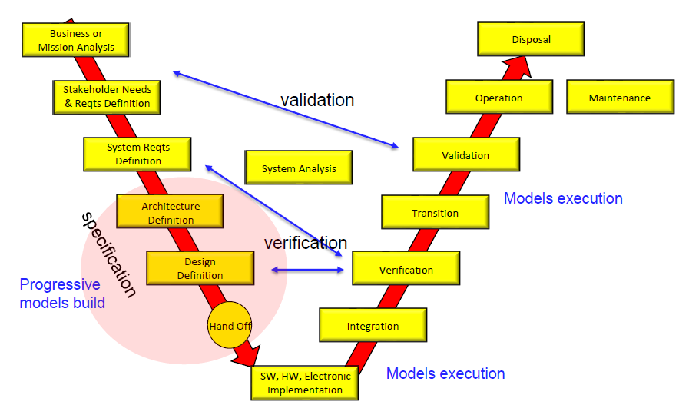
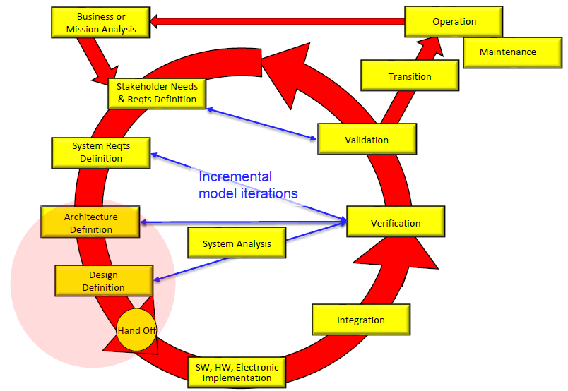
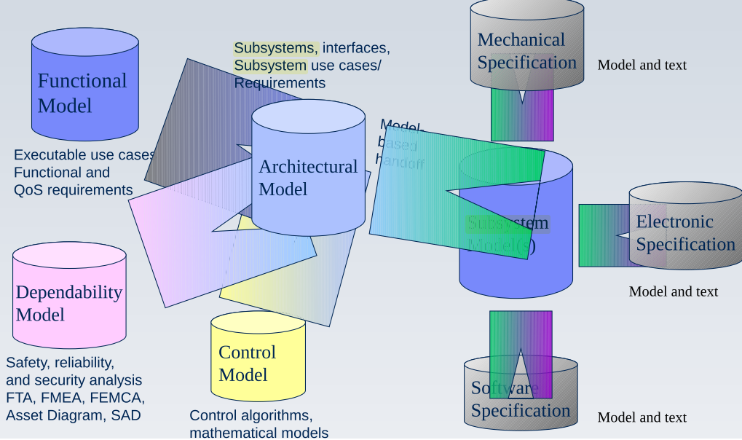
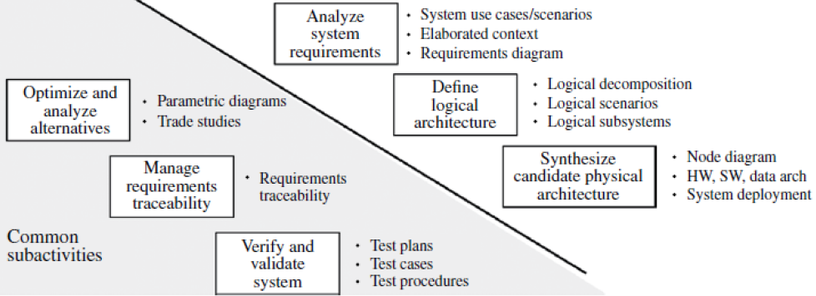
Architecture definition
MBSE Supporting traditional “V” Life-cycle, MBSE Supporting Incremental Life-cycle, and Hybrid MBSE Life-cycle
[Adapted from B. Douglass, 2016]
Models and Viewpoints in Model-Based Systems Engineering
Object-Oriented Systems Engineering Method (OOSEM) Typical Systems Requirements & Design Activities
Functional architecture view
Behavioral architecture view
Temporal architecture view
logical elements
System configuration, and
Complexity of the overall system architecture are defined
Adapted from B. Douglass, 2012]
Adapted from INCOSE SEHB,2015]

Slide 9
Measuring Complexity
Information Content = f(Complexity):
[N. P. Suh, 1995]
Goal, Question, Metric Approach (GQM) :
[J. Fischi, 2015]
where
is a probability of failure
Quantification of margins and uncertainty (QMU):
[A. Urbina, 2011]
(Behavior of Complex Systems is difficult to predict)
Structural Complexity:
[K. Sinha and O. L. De Weck, 2016]
C1: sum of complexities of individual components alone (α), which relates to the component engineering activity within a system development effort
C2: Number and complexity of each pairwise interaction βij, which relates interface design activity in a system development effort
C3: System matrix energy normalized by number of components, which represents the topological complexity that originates from the connectivity structure involving components of the system.

Slide 10
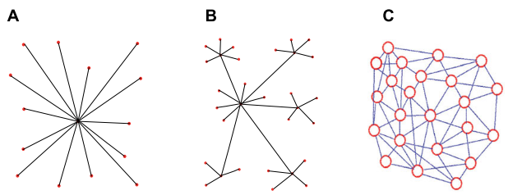
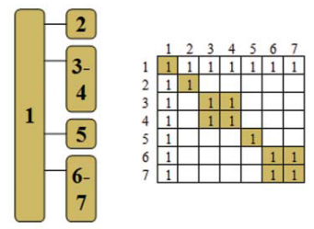
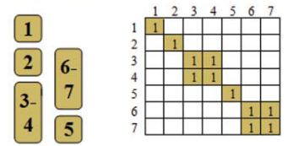
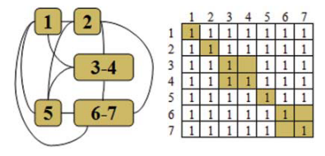
TOPOLOGICAL COMPLEXITY
Evolution of topological complexity based on their internal structure
Centralized or bus architecture
Hierarchical architecture
Distributed architecture
[K. Sinha and O. L. De Weck, 2016, –original-]
Different architecture configurations and their correspondent binary adjacency matrices
[K. Hölttä-otto et al., 2012–original- ]

Slide 11
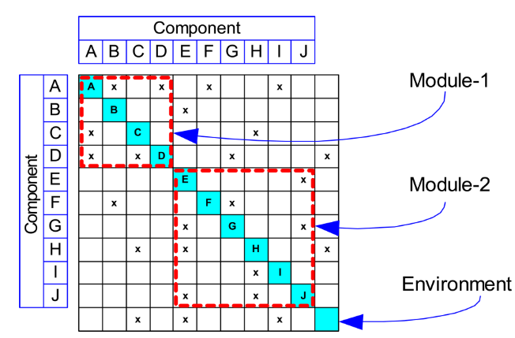
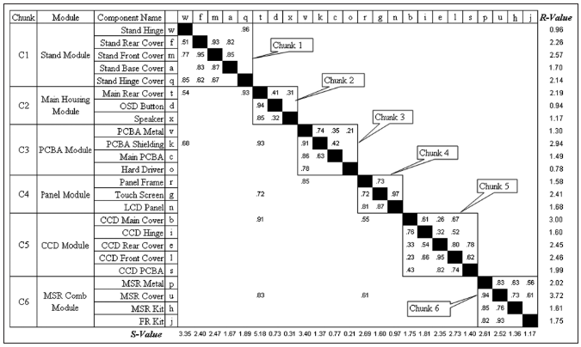
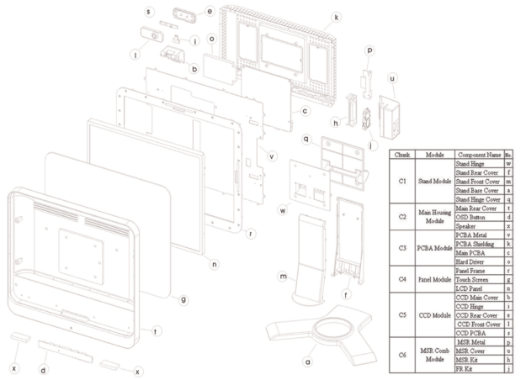
Design Structure Matrix
Example of a simple system architecture using a DSM (Design Structure Matrix):
[Y. Ko, 2013 –original-]
Example of a more complex system architecture using a FDSM (Fuzzy Design Structure Matrix):
[A. Engel, 2008 –original-]

Slide 12
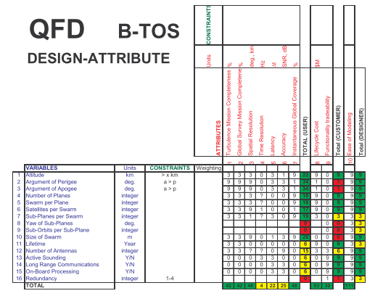
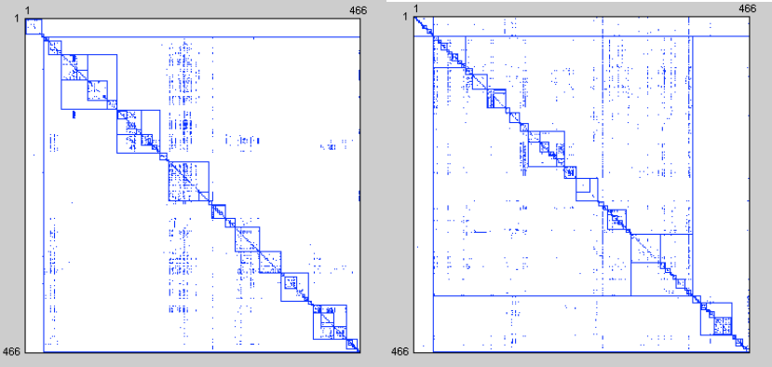
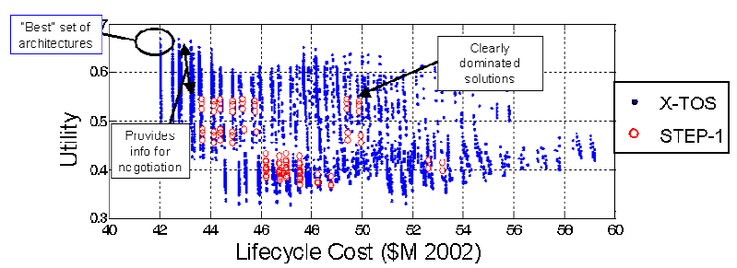
GENERATION OF TRADE SPACES
How to go from here…
Or from here…
[A. Maccormack, et al., 2010 –original-]
[A. M. Ross, 2003 –original-]
Comparison of two Similar Systems with Different Design Structures
Early Quality Functional Deployment (QFD) of Terrestrial Observer Swarm (TOS) with 16 possible design variables
To here?
[A. M. Ross, 2003 –original-]

Slide 13
GENERATION OF TRADE SPACES (a.k.a.: Solution space or Pareto front)
Current Methodologies
Methodology | Description | Pros | Cons
Fractional Factorial DOE [A. D. Maccalman et al., 2016] | - Technique of Design of experiments where a partial number of designs are chosen according with a systematic rule. | Can be very economic since does not use the total of possible design parameters | May indicate partial interactions among some but not all factors.
Monte Carlo Simulation (MCS) [A. A. Rader et al., 2010] | Pseudo-random computational sampling from probability distributions to generate multiple solution scenarios. | Can generate hundreds of thousands of design points Can approximate numerical solutions for problems difficult to solve analytically. | Unlikely to capture all sources of uncertainty Highly dependent on initial conditions. May require separate distributions for each uncertainty. Can be computationally expensive
Epoch-Era Analysis (EEA) [A. A. Rader et al., 2010] | Computational method to generate design scenarios given future uncertainties. | - Allows comparison of competing strategies under future uncertainty conditions (i.e. those that vary over time). | - Analysis is dependent on epoch enumeration and era construction steps.

Slide 14
Methodology: 1. Perform comparative analysis of metrics for modularity and structural complexity 2. Determine topological structure and interfaces 3. Apply metric to quantify efficiency of the tradespace generation 4. Generate tradespace for complexity allocation 5. Assess efficiency of generated tradespace 6. Validate approach

