Slide 1
THE ENTROPOCENE

Slide 2
A Prelude

Slide 3
Jeff Robbins
Rutgers University

Slide 4
“There is something fundamentally wrong with treating the earth as though it were a business in liquidation”
Herman Daly

Slide 5
NUTSHELL
What “The Entropocene” is about is that the Second Law of Thermodynamics, to give it an anthropomorphic spin, is not only the puppet master pulling the strings backstage of the coming about and evolution of life, it has hit upon a species capable of realizing its fondest dreams, the maximal production of what it wants, entropy. But, now there is a new kid on the block threatening to usurp our throne, exponentially advancing technology. Because the 2nd Law will not, under any circumstances, allow the sum-total of entropy in the universe, to shrink – perpetual motion machines are not allowed – and technology, especially today under the impress of artificial intelligence, machine learning, robotics, nanotechnology, breakthrough gene editing (CRSPR-cas9)… represents radically shrinking entropy, something, some system, some environment, has to compensate, has to be the recipient of its entropic effluents. That something doesn’t exclude us.

Slide 6
SYMPTOMS

Slide 7
The so called, “sixth extinction” as in other species being driven to extinction at 1,000 times pre-human levels. According to the IUCN Red List of Threatened Species, from 1996/98 to 2017 the number of threatened species more than doubled from 10,533 to 24,431, a rise of 132 percent.

Slide 8
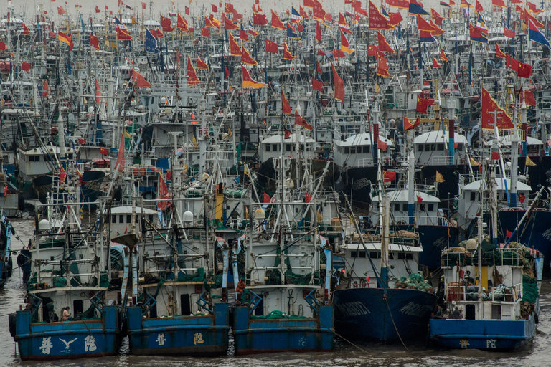
Boats in Zhoushan harbor, China’s largest fishery. Credit Gilles Sabrie for The New York Times

Slide 9
JOAL, Senegal — Once upon a time, the seas teemed with mackerel, squid and sardines, and life was good. But now, on opposite sides of the globe, sun-creased fishermen lament as they reel in their nearly empty nets.
“Your net would be so full of fish, you could barely heave it onto the boat,” said Mamadou So, 52, a fisherman in Senegal, gesturing to the meager assortment of tiny fish flapping in his wooden canoe.
A world away in eastern China, Zhu Delong, 75, also shook his head as his net dredged up a disappointing array of pinkie-size shrimp and fledgling yellow croakers. “When I was a kid, you could cast a line out your back door and hook huge yellow croakers,” he said. “Now the sea is empty.”
China’s Appetite Pushes Fisheries to the Brink,” Andrew Jacobs, The New York Times

Slide 10
Overfishing is depleting oceans across the globe, with 90 percent of the world’s fisheries fully exploited or facing collapse, according to the United Nations Food and Agriculture Organization. From Russian king crab fishermen in the west Bering Sea to Mexican ships that poach red snapper off the coast of Florida, unsustainable fishing practices threaten the well-being of millions of people in the developing world who depend on the sea for income and food, experts say.
China’s Appetite Pushes Fisheries to the Brink,” Andrew Jacobs, The New York Times

Slide 11
Kenya has a land problem. Africa itself has a land problem. The continent seems so vast and the land so open. The awesome sense of space is an inextricable part of the beauty here — the unadulterated vistas, the endless land. But in a way, that is an illusion.
Large groups of people are on the move, desperate for usable land. Data from NASA satellites reveals an overwhelming degradation of agricultural land throughout Africa, with one recent study showing that more than 40 million Africans are trying to survive off land whose agricultural potential is declining.
At the same time, high birthrates and lengthening life spans mean that by the end of this century, there could be as many as four billion people on the continent, about 10 times the population 40 years ago.
It is a two-headed problem, scientists and activists say, and it could be one of the gravest challenges Africa faces: The quality of farmland in many areas is getting worse, and the number of people squeezed onto that land is rising fast.
“Loss of Fertile Land Fuels ‘Looming Crisis’ Across Africa”
Jeffrey Gettleman
The New York Times
July 30, 2017

Slide 12
"The Earth, our home, is beginning to look more and more like an immense pile of filth.”
Pope Francis
Laudato Si’
(I.21)

Slide 13
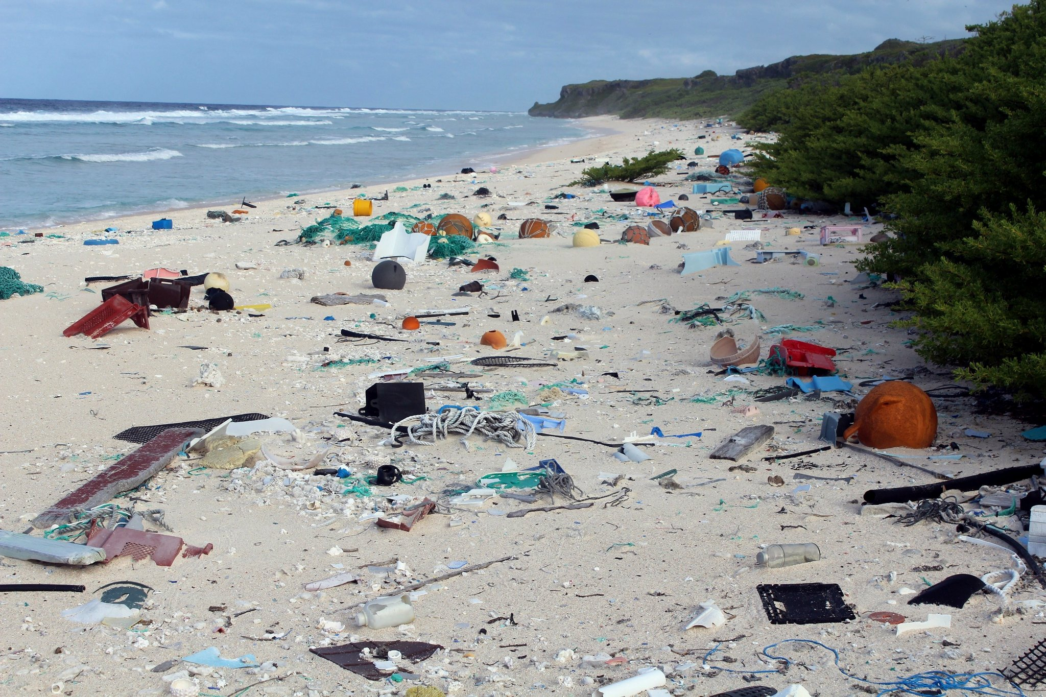
Trash on East Beach, Henderson Island, in the South Pacific Ocean.
Credit Jennifer Lavers/Institute for Marine and Antarctic Studies, via European Pressphoto Agency
Austin Ramzy, The New York Times

Slide 14
“Henderson Island ought to be one of the most pristine places on earth: an uninhabited South Pacific atoll so remote that the nearest human settlement is the small island 120 miles away where the Bounty mutineers hid out.
“But the atoll’s white sand beaches are littered with tons of multicolored plastic junk, deposited there by ocean currents. A new study estimated that the white sand beaches were littered with 17.6 tons of debris, deposited there by ocean currents.”
Austin Ramzy
“A Remote Pacific Island Awash in Tons of Trash”
The New York Times

Slide 15
“Looking down at the planet from 200 miles in space, I feel as though I know the Earth in an intimate way most people don’t─the coastlines, terrains, mountains, and rivers. Some parts of the world, especially in Asia, are so blanketed by air pollution that they appear sick…”
Scott Kelly
Excerpted from Endurance in National Geographic, “Space Odyssey”, August 2017.

Slide 16
Beijing, where the density of dangerous PM2.5 “airborne particles small enough to deeply penetrate the lungs” rises to almost 40 times the World Health Organization’s recommended concentration limit (Conner, 13 Jan. 2013) and New Delhi, which, according to the World Health Organization, has the most polluted air in the world (Harris, 8 May 2014; World Health Organization, 2014; Harris, 29 May 2015).

Slide 17
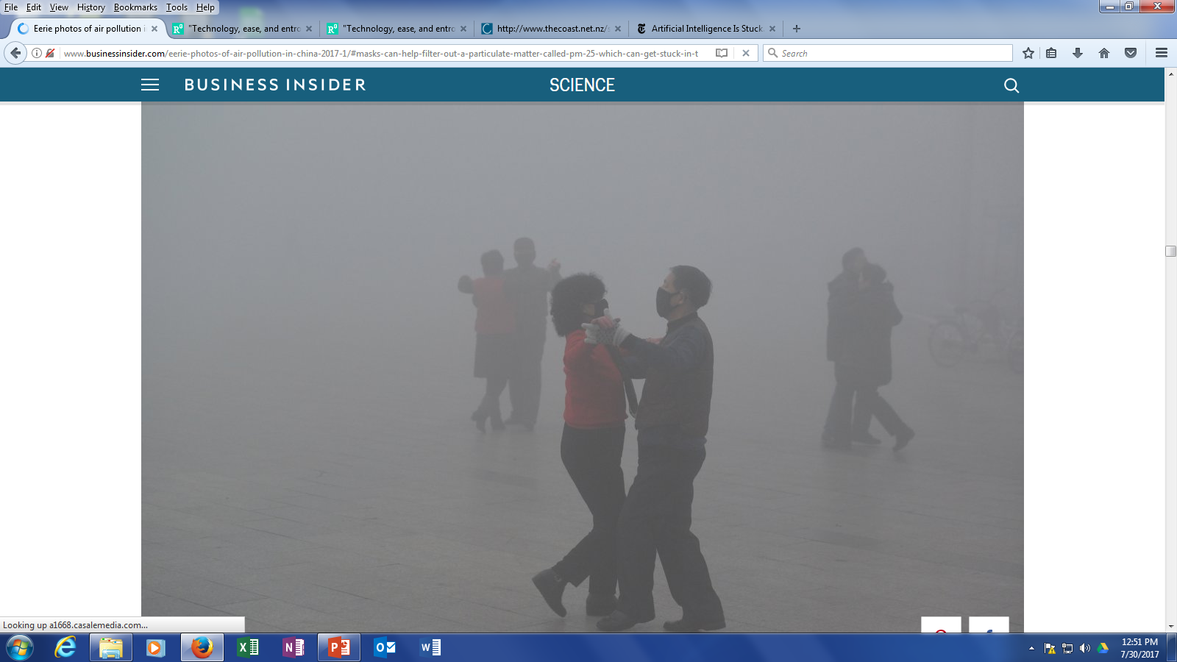
Beijing
China Daily China Daily Information Corp - CDIC/Reuters
Business Insider
http://www.businessinsider.com/eerie-photos-of-air-pollution-in-china-2017-1/#masks-can-help-filter-out-a-particulate-matter-called-pm-25-which-can-get-stuck-in-the-lungs-and-lead-to-conditions-like-asthma-and-chronic-lung-disease-9

Slide 18
Making it worse:
Climate Change

Slide 19
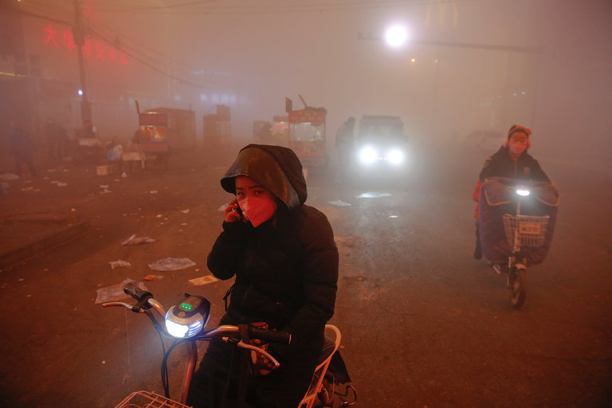
An extremely polluted December day in Shengfang, in the northern Chinese province of Hebei. New research suggests climate change may be hindering China’s efforts to solve its devastating smog crisis.
Credit Damir Sagolj/Reuters

Slide 20
New Delhi
https://www.flickr.com/photos/bdphoto1/8205641496

Slide 21
2016 was the first time that the hottest year on record occurred three times in a row.
Jugal K. Patel
New York Times
January 18, 2017

Slide 22
The image shows minimum sea-ice area from AMSR2 compared to historic summer ice extents: In orange the 30 year September mean for 1981-2010, in cyan the lowest minimum in 2012 and in red the 2007 minimum. The 2015 minimum is the fourth lowest on record.
Scientists at the University of Bremen calculate AMSR2 sea ice concentrations daily in near real time. The service is part of the GMES project Polar View and of the Arctic Regional Ocean Observing System (Arctic ROOS).
http://www.climatesignals.org/data/arctic-sea-ice-summer-minimum

Slide 23
“Human activity is estimated to be pumping almost 40 billion tons of carbon dioxide into the air every year, an amount that Dr. Canadell of the Global Carbon Project called “staggering.” The atmospheric concentration of the gas has risen by about 43 percent since the Industrial Revolution.
That, in turn, has warmed the Earth by around 2 degrees Fahrenheit, a large number for the surface of an entire planet.”
Carbon in Atmosphere Is Rising, Even as Emissions Stabilize
Justin Gillis, The New York Times, 26 June 2017

Slide 24
Over all, 1,600 coal plants are planned or under construction in 62 countries, according to Urgewald’s tally, which uses data from the Global Coal Plant Tracker portal. The new plants would expand the world’s coal-fired power capacity by 43 percent.
The fleet of new coal plants would make it virtually impossible to meet the goals set in the Paris climate accord, which aims to keep the increase in global temperatures from preindustrial levels below 3.6 degrees Fahrenheit.
Hiroko Tabuchi, “As Beijing Joins Climate Fight, Chinese Companies Build Coal Plants, New York Times

Slide 25
The U.S. Is the Biggest Carbon Polluter in History. It Just Walked Away From the Paris Climate Deal.
Justin Gillis and Nadja Popovich
New York Times, June 1, 2017

Slide 26
It has been called the “Great Dying.”
The planet’s most profound catastrophe struck 252 million years ago, at the end of the Permian period, killing 90 percent of life in the ocean and 75 percent on land. The fossil record nearly goes silent and remains startlingly impoverished for millions of years: trees disappear, bacteria replace coral reefs, insects hush. What looks like fungus spikes in the fossil record, perhaps the sepulchral rot of a dying world.
It was as close as earth has ever come to being sterilized altogether, and would take 10 million years for the planet to fully recover, setting the stage for the eventual rise of the dinosaurs.
“The End-Permian mass extinction is unique in earth history,” said Seth Burgess, a geologist with the United States Geological Survey. “Nothing else is as severe, and it’s not even close.”
A growing body of evidence suggests that this ancient apocalypse was brought on, in large part, by gigantic emissions of carbon dioxide from volcanoes that erupted across a vast swath of Siberia. Today the consequence of quickly injecting huge pulses of carbon dioxide into the air is discussed as if the threat exists only in the speculative output of computer models. But, as scientists have discovered, this has happened many times before, and sometimes the results were catastrophic.
“The rate at which we’re injecting CO₂ into the atmosphere today, according to our best estimates, is 10 times faster than it was during the End-Permian,” the paleoclimatologist Lee Kump, dean of the College of Earth and Mineral Sciences at Penn State, told me. “And rates matter. So today we’re creating a very difficult environment for life to adapt, and we’re imposing that change maybe 10 times faster than the worst events in earth’s history.”
Peter Brannon
“When Life on Earth Was Nearly Extinguished”
The New York Times, July 29, 2017

Slide 27
Hiroshima
The Fallout
Hiroshima: The medical aftermath of the day that changed the world
http://hiroshima.australiandoctor.com.au/

Slide 28
THE CLAIM

Slide 29
“[All] technological activities, regardless of whether they rely on renewable or nonrenewable resources cause the entropy of the surroundings to increase.”
T. G. Gutowski, D. P. Sekulie, and B. R. Bakshi

Slide 30
Marie-Monique Robin

Slide 31
Since February, Mr. [Scott] Pruitt has filed a proposal of intent to undo or weaken Mr. Obama’s climate change regulations, known as the Clean Power Plan. In late June, he filed a legal plan to repeal an Obama-era rule curbing pollution in the nation’s waterways. He delayed a rule that would require fossil fuel companies to rein in leaks of methane, a potent greenhouse gas, from oil and gas wells. He delayed the date by which companies must comply with a rule to prevent explosions and spills at chemical plants. And he reversed a ban on the use of a pesticide that the E.P.A.’s own scientists have said is linked to damage of children’s nervous systems.
Coral Davenport, “Counseled by Industry, Not Staff, E.P.A. Chief Is Off to a Blazing Start,” The New York Times

Slide 32
Lead Pollution Destroying Young Brains
https://www.nytimes.com/2017/06/12/world/asia/china-environmental-pollution-chemicals-lead-poisoning.html

Slide 33
Not only is the surroundings of technology the usual victims ─ the gasping air, the plastic filled oceans, the lead polluted rivers, the algae-choked lakes, the toxic chemical contaminated drinking water, the bleached dead reefs, the blown away soil, the clear cut and burned rain forests, the eviscerated fishing stocks, the poached towards extinction elephants, the vanishing tigers… ─ we are the surroundings, the environment of technology.

Slide 34
“It would be hard to overstate how pervasively technological inventions rule our actions and expectations…Caught in the routines of everyday life, we hardly notice the countless instruments and invisible networks that control what we see, hear, taste, smell, do, and even know and believe.”
Sheila Jasanoff
The Ethics of Invention: Technology and the Human Future

Slide 35
So ravenous has the concentrating of power in technics become that, elites excepted for now, drawing on the knee-jerk equating of technical progress with human progress, ever “smartening” technology is degrading us as it increasingly substitutes for the mental, physical, and social exertion needed to sustain and organize our brains, bodies, and face to face relationship skills.

Slide 36
While the degrading of human order is by no means uniform, as technology, the double-edged sword, really does do things for us, freeing us up to do and be and create what we could not do and be and create otherwise, with elites on the high end of the benefit to harm distribution benefitting far more than most because they allow the technical order to fruitfully translate empowering effort, most, unfortunately, take the path of least exertion and let the technology do the work.

Slide 37
Since human effort is what sustains and develops brains, bodies, and in-depth relationships, the rising sum of technology that is eliminating those efforts is, in effect, degrading brain, body, and bond. The result is the accelerating returns of technology is creating ever escalating cumulative advantage, the rich are getting richer across the board of power, access, skill, jobs, money, at the increasing expense of the vast bulk of humanity who only think that their smartphone always at and in hand is doing it all for them

Slide 38
A Sign of More Serious Goings On

Slide 39
WHO ARE THOSE GUYS?
Notes:
Who Are those Guys?

Slide 40
In the film classic, Butch Cassidy and the Sundance Kid, Butch and Sundance try every devious trick they know to lose the posse chasing them. Yet they keep coming on, prompting Butch to exclaim in exasperation: “Who are those guys?” Spotting one man on the ground, looking for clues, Sundance thinks it’s Lord Baltimore, a “full-blooded Indian…who could track anybody, over anything, day or night.” Perhaps the fictional Lord Baltimore was portrayed a few standard deviations beyond the average Native American’s tracking ability, but survival in a pre-GPS navigational milieu demanded such skills.

Slide 41
Native American
Sketch by Jeff Robbins
Burne Hogarth inspired

Slide 42
“The Pawnees had a detailed knowledge of every aspect of the land they would traverse. Its topography was in their minds like a series of vivid pictorial images, each a configuration where this or that event had happened in the past to make it memorable. This was especially true of the old men who had the richest store of knowledge in this respect.”
Gene Weltfish
The Way of Life of the Pawnee

Slide 43
Conventional wisdom insists that we have better things to do than find our own way from here to there without turn by turn directions. While it may be true that losing the ability to find one’s own way, as once we were compelled, may be no great loss, as a tributary feeding into the river of what’s going on across the board of human skill erosion, it’s a symptom of far more serious summing going on.

Slide 44
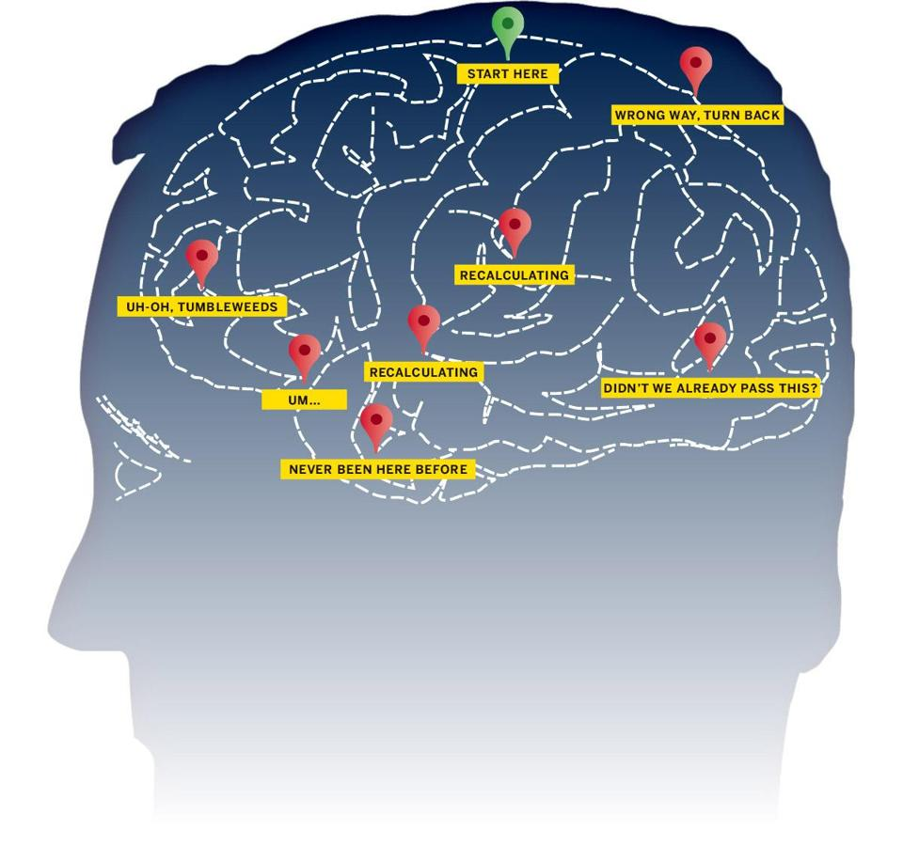
Turn by Turn
Leon Neyfakh
https://www.bostonglobe.com/ideas/2013/08/17/our-brains-pay-price-for-gps/d2Tnvo4hiWjuybid5UhQVO/story.html

Slide 45
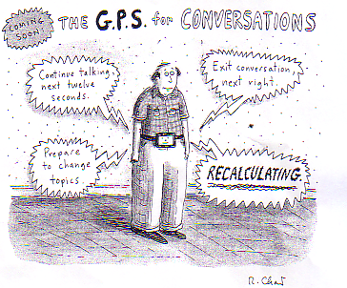
https://www.pinterest.com/pin/560838959815598127

Slide 46
“‘We can only draw an inference…[but] there’s a logical conclusion that people could increase their risk of [mental] atrophy if they stop paying attention to where they are and where they go…Society is geared in many ways toward shrinking the hippocampus…‘In the next twenty years, I think we’re going to see dementia occurring earlier and earlier’”
Véronique Bohbot
Neuroscientist
http://www.walrusmagazine.com/articles/2009.11-health-global-impositioning-systems

Slide 47
HOOKED

Slide 48
IQ2 Debate: Are We Becoming Enslaved by Our Technology?
http://www.abc.net.au/tv/bigideas/stories/2014/09/04/4081183.htm

Slide 49
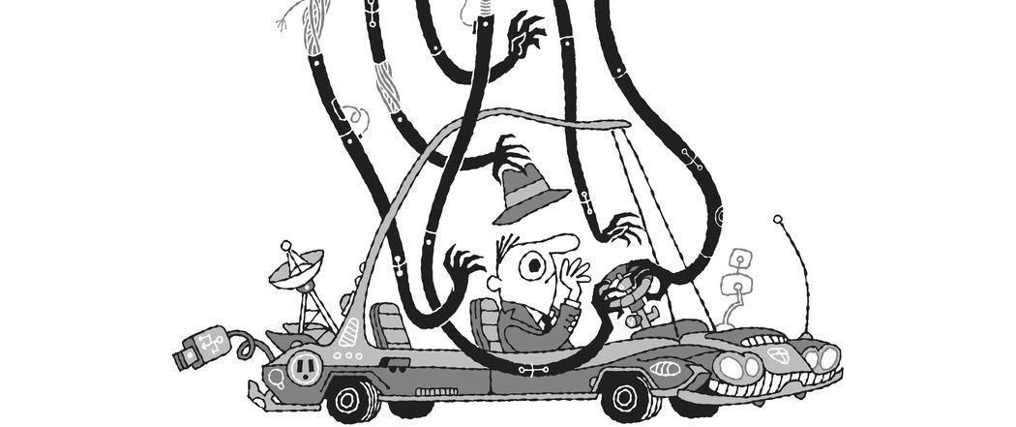
From Why ‘Smart’ Objects May Be a Dumb Idea” by Zeynep Tufekci, The New York Times. Illustration by Jim Datz

Slide 52
http://spectrum.ieee.org/cars-that-think/transportation/self-driving/eyesight-will-watch-you-drive-and-thats-a-good-thing

Slide 54
“McDonald’s hooks us by appealing to our bodies’ craving for certain flavors; Facebook, Instagram, and Twitter hook us by delivering what psychologists call “variable rewards.” Messages, photos, and “likes” appear on no set schedule, so we check for them compulsively, never sure when we’ll receive that dopamine-activating prize. (Delivering rewards at random has been proved to quickly and strongly reinforce behavior.)”
Bianca Bosker on Tristan Harris, “the Binge Breaker”
The Atlantic
https://www.theatlantic.com/magazine/archive/2016/11/the-binge-breaker/501122/

Slide 55
OVERDOSE

Slide 56
When it comes to killing pain these days, a prescription for a high-powered opioid is no longer enough. Once you’re taking, say, OxyContin or hydrocodone on a regular basis, you’ll probably get pills for the side effects: pills to control the nausea, pills to regulate your testosterone production, and pills to help you use the bathroom when the drugs numb the receptors in your intestines that are supposed to help move things along.
If you become addicted to painkillers, there are pills to help you stop taking the pills, by reducing the symptoms of withdrawal. And if you take too many pills, there’s a pill for that too. Or, rather, there’s a nasal spray, or an injection, or a nifty $4,100 auto-injector that announces, through a tiny speaker, how to use it to reverse the effects of an overdose.
Haley Sweetland Edwards
“The Drug Cascade”
Time Magazine

Slide 57
Drug Deaths in America Are Rising Faster Than Ever
AKRON, Ohio — Drug overdose deaths in 2016 most likely exceeded 59,000, the largest annual jump ever recorded in the United States, according to preliminary data compiled by The New York Times.

Slide 58
OBESITY

Slide 59
“Whereas in 2010 obesity and related illnesses killed about 1 million people, terrorists killed a total of 7,697 people across the globe, most of them in developing countries. For the average American or European Coca-Cola poses a far deadlier threat than al-Qaeda”
Yuval Noah Harari
Homo Deus: A Brief History of Tomorrow

Slide 60
A study published in The New England Journal of Medicine found that, globally, nearly 604 million adults and 108 million children are obese.

Slide 61
“In our systematic evaluation of the health effects of high BMI, we found that excess body weight accounted for about 4 million deaths and 120 million disability-adjusted life-years worldwide in 2015. Nearly 70% of the deaths that were related to high BMI were due to cardiovascular disease, and more than 60% of those deaths occurred among obese persons. The prevalence of obesity has increased during the past three decades and at a faster pace than the related disease burden. However, both the trend and magnitude of the BMI-related disease burden vary widely across countries…
“Among the leading health risks that were assessed in the Global Burden of Disease 2015 study, high BMI continues to have one of the highest rates of increase. Across levels of development, the prevalence of obesity has increased over recent decades, which indicates that the problem is not simply a function of income or wealth. Changes in the food environment and food systems are probably major drivers. Increased availability, accessibility, and affordability of energy-dense foods, along with intense marketing of such foods, could explain excess energy intake and weight gain among different populations. The reduced opportunities for physical activity that have followed urbanization and other changes in the built environment have also been considered as potential drivers; however, these changes generally preceded the global increase in obesity and are less likely to be major contributors…
“We found that 5% of the disability-adjusted life-years that were related to high BMI were from musculoskeletal disorders. Although high BMI is a major risk factor contributing to years lived with disability globally, and the economic costs associated with treatment are substantial… Our systematic evaluation of prospective observational studies showed sufficient evidence supporting a causal relationship between high BMI and cancers of the esophagus, colon and rectum, liver, gallbladder and biliary tract, pancreas, breast, uterus, ovary, kidney, and thyroid, along with leukemia.”
Ashkan Afshin, M.D., Sc.D., et al. (12 June 2017). Health Effects of Overweight and Obesity in 195 Countries over 25 Years, The New England Journal of Medicine, DOI: 10.1056/NEJMoa161436, http://www.nejm.org/doi/full/10.1056/NEJMoa1614362#t=article.

Slide 62
SOARING INEQUALITY

Slide 65
Former U.S. Secretary of Labor, Robert Reich’s film “Inequality for All” https://www.youtube.com/watch?v=fjYlr5G22IY

Slide 66
Accelerating Returns of the Technical Order (But to Whom?)

Slide 67
http://spectrum.ieee.org/biomedical/imaging/ai-designers-find-inspiration-in-rat-brains

Slide 68
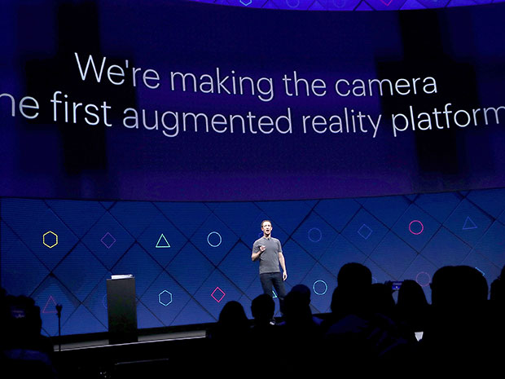
http://spectrum.ieee.org/view-from-the-valley/consumer-electronics/portable-devices/facebook-is-going-allin-on-augmented-reality

Slide 69
Technology companies aren’t just funding big things – they are funding the biggest, most world changing things. They are spending on ideas that, years from now, we may come to see as having altered life for much of the planet.
“[P]oint your phone at an object in the real world – a flower, a sign in another language, a marquee for a rock concert – and the phone will give you more information about what you’re looking at;” as a plus it will allow you to press on an instantly appearing button to seamlessly buy a concert ticket.
Farhad Manjoo
New York Times technology columnist

Slide 70
According to Sundar Pichai, Google’s chief executive, “’In an A.I.-first world, we are rethinking all our products.’…The future that the company sketched out [in Google’s 2017 developer’s conference] was one in which people communicate with their Google devices by talking to them rather than typing. And the machines will anticipate trouble without your asking. They will warn you, for instance, that you need to leave for your child’s soccer game 15 minutes early because there is heavy traffic.
Simply pointing a phone at a restaurant would bring up reviews of it. And a search for a small product – a screw driver, say – in a vast hardware store would be enabled by what Google calls Visual Position Service.
“GPS gets you to the door, and then V.P.S. can get you the exact item you’re looking for,” said Clay Bavor, Google’s virtual reality team leader. With an audio interface, V.P.S. would be a gift to the vision-impaired”
David Streitfeld
New York Times technology reporter

Slide 71
The unquestioned assumption in virtually all articles by mainstream media technology writers is the conventional wisdom, what most consumers auto-believe, that the more technology does for us, the more it serves us, the more convenient it is, the faster it responds to our every on-demand desire, “seamlessly” – a favorite term deployed to cheerlead technology’s effortlessness – the better.

Slide 72
If you can talk to your smartphone in lieu of making the effort of typing, that’s good.

Slide 73
If the machine knows you so well that it can warn you to leave 15 minutes early because it knows there is heavy traffic en route to your child’s soccer game - knowing you have a child, knowing that child plays soccer, knowing what time you take him or her to the soccer game, knowing the route you take – that’s good.

Slide 74
If you can simply point your phone at a restaurant to get reviews, that’s, of course, automatically better than having to look up reviews, even if you can just speak the request, or ask someone coming out of the restaurant how they liked their meal, or just take an intuitive chance.

Slide 75
And if you’re looking for a screw driver, GPS can turn by turn navigate you to the nearest vast hardware store - no more need to go to one of those old fashioned, all but extinct, neighborhood, no GPS to find it needed, mom and pop hardware stores where the owner knew you and could tell you where to find the screw drivers and what types and sizes they had and maybe even engage in a little chat - and once there, V.P.S. guide you to the exact item you’re looking for, no need to know how to get to the store by looking it up in Google, let alone an old fashioned, “clunky” - another favorite term used to denigrate the products of older technology and the “Luddites” who still rely on them - yellow pages, consult a map, no need to ask a store person where to find screw drivers, or if you’re vision impaired, ask to be taken to the location.

Slide 76
That’s the “A.I. first world.”

Slide 77
PERSPECTIVES

Slide 78
https://www.youtube.com/watch?v=e91D5UAz-f4&feature=youtu.be

Slide 79
According to Jeremy England, the second law of thermodynamics gives life its meaning. The law states that entropy, i.e. decay, will continuously increase. Imagine a hot cup of coffee sitting at room temperature. Eventually, the cup of coffee will reach room temperature and stay there: its energy will have dissipated. Now imagine molecules swimming in a warm primordial ocean. England claims that matter will slowly but inevitably organize itself into forms that better dissipate the warm oceanic energy.

Slide 80
William (Patrick) Ophuls (1934-)

Slide 81
“Modern man has used technology along with energy to try to transcend nature. We have seen that it cannot be done; nature is not to be transcended by a biological organism that depends on it. Worse, the attempt to do so will have momentous political and social consequences. Far from protecting us from painful and disruptive social changes, as the technological optimist is wont to claim, continued technological growth is likely to force such changes on us. We, in fact, in the process of making the Faustian bargain without ever having consciously decided to do so. As a result, we appear to be traveling down the road to total domination by technology and the machine, to the ‘Brave New World’ that Aldous Huxley (1932) warned was the logical end point of a hedonistic, high-technology civilization.”
William Ophuls

Slide 82
Jeffrey S. Wicken (1942-2002)

Slide 83
“In a universe where cosmic expansion maintains a disequilibrium between potential and thermal forms of energy, this means that putting smaller entities together to form larger entities will generate entropy through the conversion of potential energy to heat. Hence, the potential energy wells into which natural processes tend to flow are correlated with the buildup of structure … Dissipation is the driving force of the universe’s building up or integrative tendency. Entropic dissipation propels evolutionary structuring; nature’s forces give it form.”
Jeffrey S. Wicken
Evolution, Thermodynamics, and Information: Extending the Darwinian Program (Wicken, 1987, 72)
http://www.eoht.info/page/Entropy

Slide 84
William E. Rees (1974-)

Slide 85
“Emerging evidence suggests…that genetically-coded human behavioural predispositions that were highly adaptive in preindustrial times have become maladaptive in the techno-industrial age. Moreover, the values, beliefs and assumptions associated with western scientific materialism and industrial capitalism destructively reinforce this inherent biological bias against sustainability. In effect, the unsustainability of the human enterprise is an emergent property of the interaction of techno-industrial culture and the ecosphere. [The] relentless expansion of the human enterprise on a finite planet with fixed (or declining) ecosystemic energy and material flows necessarily results in accelerating biodiversity loss and diminished ecosystems integrity. Humanity displaces other species from their ecological niches. It is also becoming clear that as land and resources become scarcer, the rich and powerful members of the human family are similarly displacing the poor and powerless from their traditional lands and marginalizing them economically.”
William Rees
The Human Nature of Unsustainability, Post Carbon Institute, 2010
https://denverpdc.files.wordpress.com/2014/09/william-rees-genes-memes-and-sustainability.pdf

Slide 86
From a systems perspective, we might say that our current “unsustainability” is a product of the natural systems that led to the evolution of Homo sapiens together with the resource-intensive societal and economic systems Homo sapiens has gone on to create. Nature and nurture have combined to generate a perniciously intractable problem.
This perspective is not rooted in genetic determinism; it by no means denies that other factors contribute to humanity’s sustainability dilemma. But unless we factor in the bioevolutionary contribution, our understanding of the modern human predicament will remain unintelligibly incomplete and any “solutions” hopelessly ineffective.
William Rees, 2010

Slide 87
[We] habituate to any level of consumption (once a given level is attained, satisfaction diminishes) so the tendency to accumulate ratchets up. This is particularly so if we perceive that another social group—or country—is “getting ahead” faster than we are. Even within wealthy societies, widening income gaps lead to personal frustration and declining population health, so efforts to “keep up with the Joneses” continue unabated. It complicates matters that humans’ technological capacity to exploit nature now exceeds nature’s reproductive capacity. As fish stocks decline, we both invent new fish-finding technologies to chase remaining schools farther and deeper and switch to alternative prey species lower in the food web.
Without powerful restraints, humans—like all other species—exploit all available resources; the difference is that, with people, what is “accessible” is defined by evolving technology.
William Rees, 2010

Slide 88
ENTROPY AND THE SECOND LAW

Slide 89
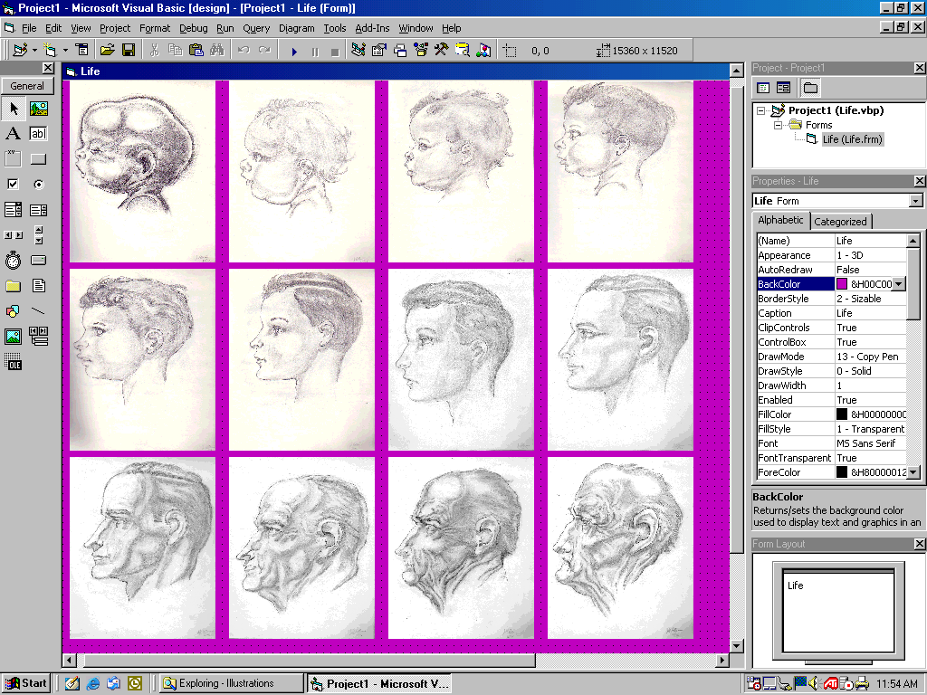
A Life
Sketches by Jeff Robbins
Burne Hogarth inspired

Slide 91
Ludwig Boltzmann - The genius of disorder (2007)
https://www.youtube.com/watch?v=hENRIAx-6D4

Slide 92
The second law of thermodynamics insists that the sum total of entropy, the measure of disorder, of gradient dissipation, has to increase.

Slide 93
Peter Atkins
https://www.youtube.com/watch?v=kwMgdLVt5I0&t=749s

Slide 94
But disorder does not increase uniformly. Pockets of high and increasing concentrations of organized matter and energy, as shrinking entropy, or what physicist Erwin Schrödinger called “negentropy” exist. If they didn’t, we wouldn’t be here. These pockets of high order, by the 2nd Law’s insistence, are always more than compensated by rising entropy in their environments in order for overall entropy to always increase. In The Second Law, Peter W. Atkins, Professor Emeritus of Chemistry at the University of Oxford in the U.K. and Fellow of Lincoln College, put it this way:

Slide 96
Metaphorically, it looks like this:

Slide 97
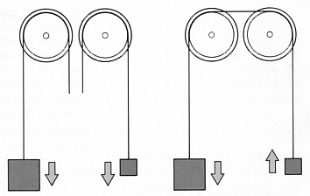
P. W. Atkins, The Second Law p. 167.

Slide 98
The twin pulleys, with falling disconnected weights represents entropy uniformly increasing. Think of it as a match thrown into a barrel of oil..

Slide 99
But now look at the linked weights over pulley. The larger falling weight represents entropy increasing. That weight pulls up the smaller weight against the natural tendency for entropy in the universe to increase. The rising weight, metaphorically, represents shrinking entropy; the emergence of organization; of structured, concentrated, purposeful, powerful, matter/energy.

Slide 100
MODUS OPERANDI: THE DISSIPATIVE STRUCTURE

Slide 101
Why does the 2nd Law allow entropy to shrink one place at the expense of someplace else? Why does it allow entropy to shrink at all?

Slide 102
The answer is the 2nd Law is a wily cat. By allowing powerful, structured energy (exergy) in the form of what the Nobel Prize winning chemist, Ilya Prigogine, called “dissipative structures” to concentrate one place, while displacing useless, spread out, degraded, dissipated, drained of exergy, energy someplace else, the law more effectively, more efficiently, produces what it wants, more entropy.

Slide 103
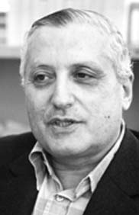
Ilya Prigogine (1917-2003)

Slide 104
HERE ARE EXAMPLES OF DISSIPATIVE STRUCTURES

Slide 105
BZ COLOR FLIPPING CHEMICAL CLOCK https://www.youtube.com/watch?v=Ch93AKJm9os

Slide 106
TORNADOES AND HURRICANES ARE DISSIPATIVE STRUCTURES (with consequences)

Slide 107
EF-5 Tornado – Moore OK, May 20, 2013 http://brocouncil.com/News/a-timelapse-video-the-moore-oklahoma-tornado

Slide 108
With Consequences

Slide 109
Hurricane Sandy, October, 2012 http://earthobservatory.nasa.gov/NaturalHazards/view.php?id=79553

Slide 110
Hurricane Sandy, October 29, 2012 With Consequences in Long Beach, NY

Slide 111
AND THEN THERE’S THE
THE BÉNARD CELL PHENOMENON

Slide 112
The formation of Bénard cells is a surprisingly easy to see case-in-point of self-organizing dissipative structures, an order out of chaos phenomenon that is central to the coming about of life.

Slide 113
The phenomenon was explored at the turn of the 20th century by the French physicist, Henri Bénard. In a series of experiments conducted in 1900 for his Ph.D. dissertation, Bénard placed slivers of fluid with different properties (e.g., viscosity, volatility) in a circular metal container. The upper surface was open to the air and the lower subjected to uniformly homogenous circulating steam heating.

Slide 114
Initially heat was transferred through the fluid by random, molecule bumping molecule thermal diffusivity (conduction). Since this mode of heat transfer is relatively inefficient, the bottom to top temperature gradient, hot to cold, begins to increase until suddenly something startling happens.

Slide 115
At a critical point, slow, inefficient, molecule bumping molecule heat transfer spontaneously transforms into far more efficient, self-organized, rotating, highly structured, hexagonal patterns of cellular vortices.

Slide 116
The spontaneous appearance of coherent patterns involving more than ten trillion billion (10²²) molecules of swirling liquid is a remarkable uptick of structural order. That order of vast numbers of linked molecules acting in concert that together form a system, represents a shrinking of entropy in the universe.

Slide 117
But since the 2nd Law will not allow entropy to shrink all by itself, the environment of the Bénard cell system must more than compensate. In fact, when Bénard cells form, the heat being transferred through the fluid sharply increases.

Slide 118
Since the heat transfer after Bénard cells form is much more rapid, a lot more heat has to be produced by the fuel, consuming it much faster, producing entropy much faster. Thus the formation of self-organized Bénard cells more efficiently gives the 2nd Law more of what it wants.

Slide 119
This is why the 2nd Law not only allows the formation of dissipative structures like Bénard cells, it wants them to form and not just to ephemerally form (when the heat is removed, the Bénard cells, along with the bottom to top gradient, quickly disintegrate) but to sustainably form as a reliable means of producing what it wants. That self-organizing sustainable means of maximizing the production of entropy is life.

Slide 120
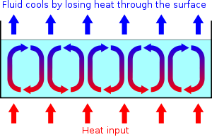

Slide 121
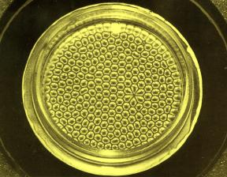
Bénard Cells
Notes:
Benard Cells

Slide 122
Cellules de Bénard https://www.youtube.com/watch?v=6BoEKUqDdLc

Slide 123
Rod Swenson The Law of Maximum Entropy Production or Why the World is in the Order Production Business http://rodswenson.com/section6.html
“The world can be expected to act opportunistically in the production of dynamical order because potentials are thereby minimized at a faster rate. The world, in short, is in the order production business because ordered flow produces entropy faster than disordered flow”

Slide 124
Life as a Dissipative Structure

Slide 125
Eric Schneider (1938-)
James Kay (1954-2004)
Dorion Sagan (1959-)

Slide 126
“Life,” as Eric Schneider and the late James Kay put it, “can be viewed as a far-from-equilibrium dissipative structure that maintains its local level of organization at the expense of producing entropy in the environment…
“[It] is a response to the thermodynamic imperative of dissipating gradients [with gradients as differences that can make a difference, in particular the huge sun to earth temperature difference]. Biological growth occurs when the system adds more of the same types of pathways for degrading imposed gradients. Biological development occurs when new types of pathways for degrading imposed gradients emerge in the system. This principle provides a criterion for evaluating growth and development in living systems… [Biological] systems develop so as to increase their energy degradation rate, and that biological growth, ecosystem development, and evolution represent the development of new dissipative pathways…This emergence of organized behavior, the essence of life, is now understood to be expected by thermodynamics. As more high quality energy is pumped into an ecosystem, more organization emerges to dissipate the energy. Thus we have order emerging from disorder in the service of causing even more disorder”
Eric D. Schneider and James J. Kay
“Order from Disorder: the Thermodynamics of Complexity in Biology”
http://citeseerx.ist.psu.edu/viewdoc/download?doi=10.1.1.512.1311&rep=rep1&type=pdf

Slide 127
“To our surprise and horror, the biosphere is becoming a technological, a biotechnological, process.”
Eric Schneider and Dorion Sagan
Into the Cool: Energy Flow, Thermodynamics, and Life

Slide 128
Is technology a dissipative structure? Or better, a system of dissipative structures whose radically shrinking entropy (or equivalently, rising exergy) is being compensated by rising entropy (shrinking exergy) in their environments.

Slide 129
Environments that not only include the biosphere. Case-in-point: Climate change thanks to our technology enabled and driven flash fire consuming of the concentrated solar energy in fossil fuels. The innovated order in fossil fuel extraction, manipulation, distribution, and use technology (as in SUVs, power plants, container ships, cruise ships, central air conditioning, circuit boards, televisions, laptops, smartphones…) emerges from the disorder of unrealized technical means causing the disorder of both irreversible consumption in a tiny sliver of time of accumulated exergy that took millions of years to form and the global scale production of heat trapping greenhouse gas.

Slide 130
Environments that not only include “the sixth extinction,” as in other species being driven to extinction at 1,000 times pre-human levels, as in the ongoing slaughter of thousands of elephants by poachers for the ivory in their tusks.

Slide 131
Environments that not only include Beijing, where the density of dangerous PM2.5 “airborne particles small enough to deeply penetrate the lungs” rises to 40 times the World Health Organization’s recommended concentration limit and New Delhi, which, according to the World Health Organization, has the most polluted air in the world.

Slide 132
Environments that not only include the record summer minimum of Arctic sea ice and 97% of Greenland surface ice melted coupled to an average daily CO₂ level that for the first time in three million years exceeded 400 parts per million.

Slide 133
The environments of accelerating, doubly exponential advancing technology, as a dissipative structure, as a system of dissipative structures concentrating order, and the power that tags along, while casting off, under the massively hyped illusion of benefit, its 2nd Law demanded entropic effluents, include us: our shrinking hippocampi; illness from obesity threatened bodies; epidemic scale, opioid fueling overdose cut short lives; lead poisoned children; with increasing cancer rates, neurodegenerative disease, reproductive disorders, diabetes tagging along, thanks to 100,000 synthetic chemicals in the environment and food chain; “Alone Together” texting ‘till you drop, absent presence degrading social structures; rich getting richer, middle class eviscerating, cumulative advantage capitalizing, artificial intelligence / robotics / machine learning driven economies without jobs…

Slide 134
As an algorithm for the creation of power churning order, technology can be viewed in the frame of gradients, differences that make a difference. With respect to we humans, that power is both sustained and grown by feeding on extractable gradients in our environment – food – and deploying the acquired exergy in the building and maintaining of internal power enabling structures of brain, body, and relationship through mental, physical, and social exertion..

Slide 135
Effort maintains and raises inner gradients. When a technology comes along eliminating that effort, pandering to powerful draw of convenience, a.k.a., the Principle of Least Effort as the primal urge to minimize calorie consuming exertion that once made survival sense in a world sans food-on-demand, what it is in effect doing is degrading the exertion generated gradients, the differences that can make an organizing difference in us.

Slide 136
Thanks to increasing reliance on technology to do more and more of the work, the advancing sum of losing it for not using it exertion removal, is weakening our mental, physical, and social muscles by rendering their exercise unnecessary, enfeebling us through ever increasing loss of the need to use, rendering us ever more dependent, collectively and individually ever more deeply in the grip of addiction to the promise of convenience, the dependency that consumes, the illusion that hooks.

Slide 137
SO THEN

Slide 138
Since the 2nd Law won’t allow the sum-total of entropy to decrease, whenever, wherever, for whatever reason, entropy shrinks, it has to rise someplace else, in the environment, the surroundings. This is the weights wrapped around pulleys metaphor. Advancing technology is shrinking entropy at a ferocious pace, feeding on itself (autocatalytically) with elite human help included in the dissipative system (for now). Though those who focus on the issue of sustainability generally focus on our collective impact on the bio-geosphere, unearthing the roots our collective impacts requires that we dig deeper.

Slide 139
William Rees claims at least part of the explanation for our “human-induced impacts [that threaten] catastrophe for billions of people while the dismal data continues to accumulate with the accelerating loss of ecosystem integrity around the world” is our genetic predispositions have become maladaptive as they are “reinforced by humanity’s technological prowess and addiction to continuous material growth.”

Slide 140
My proposal is that the genetic predisposition that lies at the heart of our unsustainability conundrum is the deep-seated, but maladapted, urge to preserve what was once precious, hard won food energy by letting technology do the work. This instinct is the direct or indirect driving force precipitating the dissipation of our brains, bodies, and real world societal bonding that in turn spills into escalating bio-geospheric degradation.

Slide 141
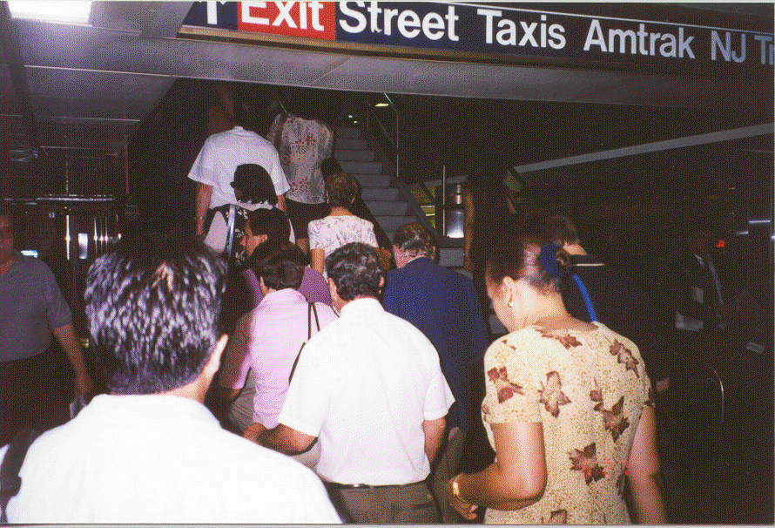
THE PRINCIPLE OF LEAST EFFORT
Penn Station, New York City. A long line waiting to take the escalator (during rush hour) to avoid climbing just eighteen steps to the next level.

Slide 142
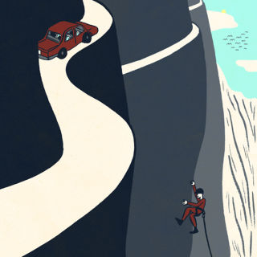
Tim Wu, “The Problem with Easy Technology,” The New Yorker
http://www.newyorker.com/tech/elements/the-problem-with-easy-technology

Slide 143
Jeffrey Wicken claims that “Dissipation is the driving force of the universe’s building up or integrative tendency. Entropic dissipation propels evolutionary structuring; nature’s forces give it form.” I will carry on where he leaves off by arguing that entropic dissipation is propelling advancing technology and the modus operandi, “nature’s force’ is the systematic, massively marketed capitalizing on the driven maladaptive urge to preserve energy by whatever means promises “Made Easy”, whatever is differentially more seamlessly convenient, demands less mental, physical, or social exertion.

Slide 144
Technology caters to the urge, creating dependency, feeding on addiction, rendering us more and more helpless without smartphone in hand, without apps to guide, remind, think for us, make decisions for us, do the work for us. The sustainability rub is satisfying the addiction, eliminating the human effort, creating the demand, requires more and more organization being poured into the complex technics. The process shrinks entropy by raising technical exergy / power / organization. That shrinking, that rising in systemic technospheric evolution, by 2nd Law demand, must and will be compensated by displaced entropy, degraded exergy.

Slide 145
One of the recipients of the entropic effluents, as previously noted, is the human brain, body, and social bonding. The other is the bio-geosphere supporting both still increasing billions of us humans and more significantly and asymmetrically - the few consuming far far more than the many – the global scale consumption of resources, the pumping out of greenhouse gases, the devouring of other species either directly or by eliminating their habitats.

Slide 146
As William Rees observed: “Without powerful restraints, humans—like all other species—exploit all available resources; the difference is that, with people, what is “accessible” is defined by evolving technology…[Our] competitive drive as K-strategists is relentless; we have no built-in “off” switch tripped by sufficiency. On the contrary, we habituate to any level of consumption (once a given level is attained, satisfaction diminishes) so the tendency to accumulate ratchets up. While Rees was focused on bio-geospheric resources, his claim applies to we human resources. Only with us, the exploitation is not being driven by us, en-masse; it is being driven by the tiny in number technical, corporate, and financial elites in pursuit of profit.

Slide 147
IN SUM

Slide 148
For Jeffrey Wicken, “natural organizations are informed dissipative structures, maintaining themselves by autocatalytically focusing resources into the production of their organizational relationships.” Advancing technology, in all of its myriad instantiations, is what might be characterized as a meta-dissipative structure, a nested, networked, hierarchical, collective [system] of dissipative structures, concentrating order, and the power that order confers, in its hardware and software and in those on whom it depends (for now) for further development ─ the creative disruptive innovators, engineers, scientists, elite technologists, venture capitalists, mega-multinational corporations, cutting edge startups… ─ while discharging entropy into its/their environment(s) to meet the demand of the classical statement of the 2nd Law that the sum total entropy in the universe always goes up, never down.

Slide 149
If entropy goes down one place, as in, say, a smartphone, or GPS app, it must and will go up in the environment of the smartphone, the environment of the app. What is the environment of the smartphone? What is the environment of the app, the totality of apps? Answer: it is the brain of the user of that smartphone losing the neural connections that would have been made had the brain done the work; it is the user of the GPS app that does the navigational work, dissipating the “cognitive map”, the mental order that would have been created in the hippocampus had the traveler found his or her way without turn by turn.

Slide 150
If we, in our own lives, are strongly drawn to taking paths that minimize food energy consuming exertion, letting the technology do more and more of the work for us, we are also collectively, on all levels, drawn to take paths that minimize exertion. And that’s the sustainability conundrum. We are failing to successfully and sustainably reduce greenhouse gas emissions because it would take more collective human / political effort to reduce the emissions than just carrying on business as usual. Why do we still rely on and use fossil fuels for the lion’s share of our energy? Because extracting and consuming fossil fuels, as concentrated, high exergy, solar energy gives the 2nd Law more of what it wants, more efficiently, more conveniently. Entropy. The entropy of irreversibly degraded fossilized solar energy. The entropy of spread out, eviscerated, degraded solar energy in carbon dioxide emissions on a vast and still growing global scale.

Slide 151
What we have is a
DISORDER OF ORDERS
What we need is an
ORDER OF ORDERS

Slide 152
If the bulk of humanity communicated and acted with the cohesiveness of a flock of fast moving birds swooping and soaring in concert, sustainability wouldn't be a problem.

Slide 153
If overpopulation is the problem, as a species we would get the message and go to work reducing the burden of sheer numbers.

Slide 154
If our collective rate of non-renewable resource consumption is the problem, the species would work as a team to phase out its consumption and phase in renewable replacements.

Slide 155
If unequal distribution of the support structures for life is the problem, those who have more than they need would immediately set about seeing to it that their less fortunate brothers and sisters around the world began getting their fair share.

Slide 156
If the drug of ceaseless economic growth is the problem, concerted measures to reduce frivolous consumption and selective increases in needed consumption would spontaneously arise.

Slide 157
Unfortunately, barring global catastrophe, this degree of global cohesiveness in service of our common future is not going to happen anytime soon. Before any sense of unified purpose, an order of orders, a “we” targeting the creation of a dynamically sustaining future can first step begin to be achieved, the puppet master, the 2nd Law’s lust for entropy, working against the realization without end, must be recognized and encountered up and down the scales of humanity.

Slide 159
Humanity is feverishly working at cross purposes with its own survival as a species. We need a “we” to grasp why.

Slide 160
TAKEAWAY

Slide 161
Advancing technology, at doubly exponential accelerating pace, by 2nd Law insistence, is discharging its entropic effluents into people and human social structures by dissipating brain, body, and bond sustaining effort. The parallel accelerating consumption dependency the erosion of human effort produces spills into the bio-geosphere as toxic pollution, as the “sixth extinction” of life, as out of control tipping point crossing climate change... Coupled to still exponentially rising human populations, business as usual, there’s no sustainable future for us.

Slide 162
Recognizing our common future conundrum, including the string pulling role of the Second Law of Thermodynamics, tracing back to the origins of order in the universe, including life, along with the driven out-of-whack, primal urge to preserve what was once precious food energy by letting technology do more and more of the work, coupled to our failure to educate and empower women and the failure to illuminate the explosive nature of exponential growth, is a first step en route to not serving as entropy’s puppets.

Slide 163
For the sake of our future’s children

Slide 164
My fellow Americans humans, ask not what your country planet can do for you, ask what you can do for your country planet.

Slide 165
POSTSCRIPT
A Tragedy of the Commons (Writ Large)

Slide 166
“Our climate-and-energy dilemma is really a world-sized version of the tragedy of the commons. It would be in the collective interest of all parties to manage the earth’s resources for maximum longevity─that is, to manage them for sustainability, or what William Stanley Jevons* called mediocrity. Yet as consuming individuals we have a conflicting but irresistible short-term interest in grabbing as much as we can, even if by doing so we bring eventual harm to ourselves and our descendants─since we personally enjoy all the benefits of our own consumption, yet share the consequences with everyone else, and primarily with people not yet born.”
David Owen
The Conundrum
*The Jevons Paradox, a.k.a., “the rebound effect”: “It is wholly a confusion of ideas to suppose that the economical use of fuel is equivalent to a diminished consumption. The very contrary is true.” (as qtd by David Owen).

Slide 167
Today, the global human population is increasing exponentially at a rate just over one percent -1.182 percent in 2016
http://data.worldbank.org/indicator/SP.POP.GROW

Slide 168
According to a 2015 UN Department of Social and Economic Affairs estimate world population could reach 9.5 billion in 2050 and 11.2 billion by 2100. The estimates assume that the current one percent and change growth rate will diminish.
But what if it doesn’t? What if the growth rate continues at a one percent rate? And why stop at the year 2100? Our human species has been around for hundreds of thousands of years. If you’re going to consider and plan for long term sustainability, you need to entertain really long term periods for that’s what sustainability means. What follows is a series of charts indicating what human population levels will reach for periods up to 10,000 years which is still a tiny sliver of our species residence on the planet at an annual one percent per year growth rate.

Slide 178
That’s 122,687,153,339,181,000,000,000,000,000,000,000,000,000,000,000,000,000 people on earth 10,000 years from now if human population continues to grow at the rate of one percent per year.

Slide 179
World Population 10,000 Years from Now with Annual Growth Rates Varying from one to minus one percent
1 | 122,687,153,339,181,000,000,000,000,000,000,000,000,000,000,000,000,000
0.1 | 164,375,110,042,863
0.01 | 20,386,094,451
0.001 | 8,288,777,741
0.0001 | 7,575,376,215
0 | 7,500,000,000
-0.0001 | 7,425,373,716
-0.001 | 6,786,277,242
-0.01 | 2,758,957,848
-0.1 | 338,800
-1 | 0

Slide 180
THE GIST

Slide 181
In no way can there be a long term sustainable future if human population continues to increase at the current annual one percent rate. Or a 0.1 percent rate, or even a 0.01 percent rate.

Slide 182
REFERENCES
Alter, A. (2017). Irresistible: The Rise of Addictive Technology and the Business of Keeping Us Hooked, Penguin Press, New York.
Anand, G. (14 Feb. 2017). India’s Air Pollution Rivals China as World’s Deadliest, The New York Times.
Ashkan Afshin, M.D., Sc.D., et al. (12 June 2017). Health Effects of Overweight and Obesity in 195 Countries over 25 Years, The New England Journal of Medicine, DOI: 10.1056/NEJMoa161436, http://www.nejm.org/doi/full/10.1056/NEJMoa1614362#t=article.
Bakan, J. (2004). The Corporation: The Pathological Pursuit of Profit and Power, Free Press,
New York.
Bishop, A. (21 Sept. 2012). Arctic sea ice at record low, Earth Times, http://www.earthtimes.org/climate/arctic-sea-ice-record/2189/
Bishop, A. (25 July 2012). 97% of Greenland’s surface ice melts in two weeks, Earth Times, July 25, 2012, accessed January 15, 2013; http://www.earthtimes.org/climate/97-percent-greenland-surface-ice-melts-weeks/2098/
Brynjolfsson, E. and McAfee, A. (July/Aug. 2015). Will Humans Go the Way of Horses,
Foreign Affairs.
Brisendine, J. (2014). New Insights into Irreversibility,
http://www.newcriticals.com/new-insights-on-irreversibility/print
Carr, N. (2014). The Glass Cage: Automation and Us, W. W. Norton, New York.
Ceballos, G., et al. (19 June 2015). Accelerated modern human-induced species losses: Entering
the sixth mass extinction, Science Advances, 10.1126/sciadv.1400253, http://advances.sciencemag.org/content/advances/1/5/e1400253.full.pdf
Christie, B. (Oct. 2012). Blood Ivory, National Geographic,
http://ngm.nationalgeographic.com/2012/10/ivory/christy-text.
Condon B. and Wiseman, P. (23 Jan. 2013). AP IMPACT: Recession, tech kill middle-class jobs,” Associated Press, http://www.huffingtonpost.com/huff-wires/20130125/us-the-great-reset-disappearing-jobs/?utm_hp_ref=green&ir=green
Conner, N. (13 Jan. 2013). Beijing choked by third day of hazardous smog (Update 2), Phys.org, htt4://phys.org/news/2013-01-beijing-day-hazardous-smog.html
Critser, G. (2003). Fat Land: How Americans Became the Fattest People in the World,
Houghton Mifflin, Boston.
Daly, H. E. (1977, 1991). Steady-state Economics: The Economics of Biophysical Equilibrium and Moral Growth. W.H. Freeman, San Francisco.
Editorial Board. (3 May 2017). China Wants Fish, So Africa Goes Hungry, The New York Times.
England, J. L. (4 Nov. 2015). Dissipative adaptation in driven self-assembly,
Nature Nanotechnology 10: 919-923.
Fife, D. (1971). Killing the Goose,” Environment, 13(3):20-27.
Ford, M. (2015). Rise of the Robots: Technology and the Threat of a Jobless Future,
Basic Books, New York.
Fowler, C. W. and Hobbs, L. (2003). Is Humanity Sustainable?, Proceedings of the Royal
Society of London, Series B: Biological Sciences 270: 2579–2583.

Slide 183
Gazzaley, A. and Rosen. L D. (2016). The Distracted Mind: Ancient Brains in a High-Tech
World, MIT Press, Cambridge, MA.
Gillis, J. (10 May 2013). Heat-Trapping Gas Passes Milestone, Raising Fears,
The New York Times.
Gillis, J. (25 June 2015). Naomi Oreskes, A Lightening Rod in a Changing Climate,
The New York Times
Greenfield, S. (2015). Mind Change: How Digital Technologies Are Leaving Their Mark On Our
Brains, Random House, New York.
Gutowski, T.G. Sekulie, D.P., and Bakshi, B.R. (2009). Preliminary Thoughts on the Application
of Thermodynamics to the Development of Sustainability Criteria, Proceedings of the IEEE
International Symposium on Technology and Society,
http://www.computer.org/portal/web/csdl/doi/10.1109/ISSST.2009.5156699.
Hansen, J. et al. (2008). Target Atmospheric CO₂ : Where Should Humanity Aim?, arXiv:0804.1126v3 [physics.ao-ph], http://arxiv.org/ftp/arxiv/papers/0804/0804.1126.pdf.
Harari, Y. N. (2016). Homo Deus: A Brief History of Tomorrow, Harper/Harper Collins, New York.
Hardin, G. (1968). The Tragedy of the Commons, Science, 162:1243-1248.
Harris, G. (8 May 2014). Cities in India Among the Most Polluted, W.H.O. Says, New York
Times.
Harris, G. (29 May 2015). Holding Your Breath In India, The New York Times.
Hernández, J. C. (24 Mar. 2017). Climate Change May Be Intensifying China’s Smog Crisis, The New York Times.
Hernández, J. C. (12 June 2017). ‘No Such Thing as Justice’ in Fight Over Chemical Pollution in China, The New York Times.
Hogarth, Burne (1965, 1989). Drawing the Human Head, Watson-Guptill Publications, New York.
Hutchinson, A. (14 Oct. 2009). Global Impositioning Systems: Is GPS technology actually harming our sense of direction?, The Walrus, http://www.walrusmagazine.com/articles/2009.11-health-global-impositioning-systems
Intelligence Squared (IQ2) Debate We are becoming enslaved by
our technology, http://www.abc.net.au/tv/bigideas/stories/2014/09/04/4081183.htm.
IUCN Red List (2017-1). The IUCN Red List of Threatened Species, http://www.iucnredlist.org/.
Joy, B. (April 2000). Why the Future Doesn’t Need Us, Wired Magazine,
http://archive.wired.com/wired/archive/8.04/joy.htmlLongstaff, S. (12 Aug. 2014).
Kahneman, D. (2011). Thinking Fast and Slow, Farrar, Straus and Giroux, New York.
Kelly, K. (2010). What Technology Wants, Viking, New York.
Kolbert, E. (2014). The Sixth Extinction: An Unnatural History, Henry Holt, New York.

Slide 184
Kroft, S. (13 Jan. 2013). Are Robots hurting job growth? 60 Minutes,
http://www.cbsnews.com/8301-18560_162-57563618/are-robots-hurting-job-growth/.
Kunzig, R. (9 May 2013). Climate Milestone: Earth’s CO2 Level Passes 400 ppm: Greenhouse Gas highest since the Pliocene, when sea levels were higher and the Earth was warmer, National Geographic News, http://news.nationalgeographic.com/news/energy/2013/05/130510-earth-co2-milestone-400-ppm/.
Kurzweil, R. (7 Mar. 2001). The Law of Accelerating Returns, Kurzweil Accelerating Intelligence, http://www.kurzweilai.net/the-law-of-accelerating-returns Lavers, J. L. and Bond, A. L. (15 May 2017). Exceptional and rapid accumulation of anthropogenic debris on one of the world’s most remote and pristine islands, PNAS 114(23): 6052-6055, http://www.pnas.org/content/114/23/6052.full
Manjoo, F. (18 May 2017). Google, Not the Government is Building the Future, The New York Times.
Meyer, R. (2 Aug. 2017). Your Smartphone Reduces Your Brainpower, Even If It's Just Sitting There, The Atlantic.
https://www.theatlantic.com/technology/archive/2017/08/a-sitting-phone-gathers-brain-dross/535476/
Nicolis, G. and Prigogine, I. (1989). Exploring Complexity: An Introduction. W. H. Freeman, New York.
NASA, NOAA Find 2014 Warmest Year in Modern Record (16 Jan. 2015). National
Aeronautics and Space Administration, Goddard Institute for Space Studies.
http://www.giss.nasa.gov/research/news/20150116/.
Nestle, M. (2002). Food Politics: How the Food Industry Influences Nutrition and Health,
University of California Press, Berkeley, CA.
North, A. (23 June 2015). Skyrocketing Extinctions Put Humans at Risk, New York Times.
Nourbakhsh, I. R. (July/Aug. 2015). The Coming Robot Dystopia: All Too Inhuman, Foreign Affairs.
O’Brien, A. (16 Jan. 2017). Ask Alexa? No, Hear This Alexa. The New York Times.
O’Neil, C. (2016). Weapons of Math Destruction: How Big Data Increases Inequality and Threatens Democracy, Crown, New York.
Owen, D. (2011). The Conundrum:How Scientific Innovation, Increased Efficiency, and Good Intentions Can Make Our Energy and Climate Problems Worse, Riverhead, New York.
Ophuls, W. (1977). Ecology and the Politics of Scarcity: A Prologue to A Political Theory of the Steady State, W. U. Freeman, San Francisco.
Prigogine, I. (1955). Thermodynamics of irreversible processes. John Wiley and Sons, New York, cited in Schneider, E. D. & Sagan, D., 81.
Ramzy, A. (16 May 2017). A Remote Pacific Island Awash in Tons of Trash. The New York Times.
Rees, W. (2010). The Human Nature of Unsustainability, Post Carbon Institute, https://denverpdc.files.wordpress.com/2014/09/william-rees-genes-memes-and-sustainability.pdf
Richtel, M. (12 June 2017). More than 10 Percent of the World’s Population is Obese, Study Finds, The New York Times.
Rigney, D. (2010). The Matthew Effect: How Advantage Begets Further Advantage, Columbia University Press, New York.
Robbins, J. (2000). A Case for the Minimum: Least Effort as Meta Umbrella, Proceedings of 44th Annual Conference of ISSS International Society for the Systems Sciences.
Robbins, J. (2006). Technology and the Gene for Minimizing Effort. Proceedings of the IEEE
International Symposium on Technology and Society, http://ieeexplore.ieee.org/xpl/articleDetails.jsp?arnumber=4375895&queryText=Technology+and+the+Gene+for+Minimizing+Effort&newsearch=true&searchField=Search_All
Robbins, J. (2007). Gaming: The Technology / Energy Efficiency Hook, Proceedings of the
IEEE International Symposium on Technology and Society, http://ieeexplore.ieee.org/xpl/articleDetails.jsp?&arnumber=4362232.
Robbins, J. (2008). Cannibalizing Childhood’s Future as Rising to Falling Rope, Proceedings of the 2008 International Society for the Systems Sciences Conference, http://journals.isss.org/index.php/proceedings52nd/article/viewFile/988/318.

Slide 185
Robbins, J. (Fall 2010). Standing in the Way: Sustainable Future vs. Sloth, Genes, and Entropy, IEEE Technology and Society Magazine, 39(3): 14-21. http://ieeexplore.ieee.org/xpl/login.jsp?tp=&arnumber=5571928&url=http%3A%2F%2Fieeexplore.ieee.org%2Fxpls%2Fabs_all.jsp%3Farnumber%3D5571928.
Robbins, J. (2011). GPS: A Turn by Turn Case-In-Point, Journal of Cases in Information Technology, 13(2):1-18, http://www.igi-global.com/article/gps-turn-turn-case-point/54463.
Robbins, J. (2013). If Technology is a Dissipative Structure, Bring it On Deserves a Closer Look,
Proceedings of the IEEE International Symposium on Technology and Society, http://ieeexplore.ieee.org/xpl/articleDetails.jsp?arnumber=6613117
Robbins, J. (2015). Anthropocene as Life’s State of the Art in Disorder Production: A Sustainability Conundrum, Proceedings of the 2015 International Society for the Systems Sciences Conference, http://journals.isss.org/index.php/proceedings59th/article/view/2689 .
Robbins, J. (Mar. 2015). Ruminations on the IQ2 Debate: We Are Becoming Enslaved by Our
Technology, IEEE Technology and Society Magazine, http://ieeexplore.ieee.org/stamp/stamp.jsp?arnumber=7064867 Robin, M-M. (2011, 2014). Our Daily Poison: From Pesticides to Packaging, How Chemicals Have Contaminated The Food Chain and Are Making Us Sick (Schein, A. and Vergnaud, L., trans.), New York, The New Press.
Sayre, K. M., (2010). Unearthed: The Economic Roots of Our Environmental Crisis, University of Notre Dame Press, Notre Dame, Indiana.
Salkin, A. (24 Mar. 2017). Take a Load off, The Robots That Fold Laundry Are Coming, The
New York Times.
Schneider, E. D. and Sagan, D. (2005). Into the Cool: Energy Flow, Thermodynamics and
Life, University of Chicago Press, Chicago.
Schneider, E. D. and Kay, J. (1995). Order from disorder: the thermodynamics of complexity in
Biology, in What is Life? The Next Fifty Years (P. Murphy and L. O’Neill, eds.),
Cambridge University Press, Cambridge.
Schrödinger, E. (1944). What is Life? The Physical Aspect of the Living Cell, Cambridge
University Press, Cambridge.
Sukuya, M. (2013). “Exergy-Entropy Process in Global Environmental Systems” Ch. 2 in
Exergy: Theory and Applications in the Built Environment, Springer,
https://www.google.com/#q=exergy-entropy+process+of+global+environmental+system.
Streitfeld, D. (18 May 2017). Google Prepares for a Future in which It Is Always With You, and
Listening, The New York Times.
Tétard, F. and Collan, M. (2009). Lazy User Theory: A Dynamical Model to Understand User
Selection of Products and Services, 42nd Hawaii International Conference on System Sciences, http://www.computer.org/portal/web/csdl/doi/10.1109/HICSS.2009.802.
Tolman, E. C. (1948). Cognitive Maps in Rats and Men, The Psychological Review, 55(4): 189-
208, http://psychclassics.asu.edu/Tolman/Maps/maps.htm
Turkle, S. (2011). Alone Together: Why We Expect More From Technology and Less From Each Other, Basic Books, New York.
Turkle, S. (2015). Reclaiming Conversation: The Power of Talk in a Digital Age, Penguin Press, New York.
Twenge, J. M. (Sept. 2017). Have Smartphones Destroyed a Generation?, The Atlantic.
https://www.theatlantic.com/magazine/archive/2017/09/has-the-smartphone-destroyed-a-generation/534198/
Ward, A. F., et al., Brain Drain: The Mere Presence of One’s Own Smartphone Reduces Available Cognitive Capacity, Journal of the Association for Consumer Research, 2(2), http://www.journals.uchicago.edu/doi/abs/10.1086/691462

Slide 186
Weisman, A. (2013). Countdown: Our Last, Best Hope for a Future on Earth, Little Brown,
Boston.
Wicken, J. S. (1987). Evolution, Thermodynamics, and Information: Extending the Darwinian
Paradigm, Oxford University Press, Oxford.
Wilson, E. O. (1975). Slavery in Ants, Scientific American, 232(6): 32-36,
https://archive.org/details/ants_13347
Wilson, E. (12 Dec. 2001). On Bjorn Lomborg and Extinction, grist,
http://www.grist.org/article/point.
Wolchover, N. (22 Jan. 2014). A New Physics Theory of Life, Quanta Magazine,
https://www.quantamagazine.org/a-new-thermodynamics-theory-of-the-origin-of-life-20140122
World Health Organization (2014). Ambient (outdoor) air pollution in cities database 2014.
Wu, T. (6 Feb. 2014). As Technology Gets Better, Will Society Get Worse, The New Yorker,
http://www.newyorker.com/tech/elements/as-technology-gets-better-will-society-get-worse.
Wu, T. (21 Feb. 2014). The Problem with Easy Technology, The New Yorker,
http://www.newyorker.com/tech/elements/the-problem-with-easy-technology.

